Slide 1

Python Advanced

Slide 2
Introduction

Slide 3
Program
Python Recap
Python Advanced Concepts
File Formats
Pickle
XML
JSON
Database Access
ORM
SqlAlchemy
Web Frameworks
Pyramid
Django
Flask

Slide 4
Topics
Pythonic / Idiomatic Python
OO - associations
virtual environments
type hinting
logging
zipfile
pylint
docstrings
pydoc
unit testing
File I/O
Concurrency
GUI
configparser
git & github
functools
itertools
pathlib
shutil
dateutil, calendar, arrow
database access
web applications
executables

Slide 5
Python Basics
Built-in numeric types: bool, int, float, complex
Operators: arthimetic, comparative, boolean
Strings: concatenation, string methods, formating, unicode
Flow statements: while, for, if-elif-else
Functions: arguments, default values, variadic arguments, keyword arguments, return value, lambda
Built-in functions
Reading from and writing to files, context manager
Lists: indexing, slicing, modification, unpacking, comprehesion
Dicts: creation, modification, iterating
Object Orientation: classes, objects, methods and attributes

Slide 6
Advanced Python

Slide 7
Pythonic / Idiomatic Python
PEP 8 – Style Guide for Python Code https://peps.python.org/pep-0008/

Slide 8
pip
Usage:
pip <command> [options]
Commands:
install Install packages.
download Download packages.
uninstall Uninstall packages.
freeze Output installed packages in requirements format.
inspect Inspect the python environment.
list List installed packages.
show Show information about installed packages.
check Verify installed packages have compatible dependencies.
config Manage local and global configuration.
search Search PyPI for packages.
cache Inspect and manage pip's wheel cache.
index Inspect information available from package indexes.
wheel Build wheels from your requirements.
hash Compute hashes of package archives.
completion A helper command used for command completion.
debug Show information useful for debugging.
help Show help for commands.
$ pip list > requirements.txt
$ pip install -r requirements.txt

Slide 9
Project structure
helloworld/
│
├── bin/
│
├── docs/
│ ├── hello.md
│ └── world.md
│
├── helloworld/
│ ├── __init__.py
│ ├── runner.py
│ ├── hello/
│ │ ├── __init__.py
│ │ ├── hello.py
│ │ └── helpers.py
│ │
│ └── world/
│ ├── __init__.py
│ ├── helpers.py
│ └── world.py
│
├── data/
│ └── input.csv
│
├── tests/
│. ├── hello
│ │ ├── helpers_tests.py
│ │ └── hello_tests.py
│ │
│ └── world/
│ ├── helpers_tests.py
│ └── world_tests.py
│
├── .gitignore
├── LICENSE
├── README.md
├── requirements.txt
├── setup.py
└── venv/
https://docs.python-guide.org/writing/structure/
"""Script to ..."""
import sys
def main():
"""Main entry point for the script."""
pass
if __name__ == '__main__':
sys.exit(main())

Slide 10
Import
import in a script
vs
import in a package
try:
from .encryption import Encryption
except ImportError:
from encryption import Encryption
https://realpython.com/python-import

Slide 11
Virtual Environments
Python virtual environments aim to provide a lightweight, isolated Python environment
venv
virtualenv
The package is a superset of venv, which allows you to do everything that you can do using venv, and more
$ python -m venv venv
$ venv\Scripts\activate # windows
$ source venv/bin/activate # macos
$ deactivate

Slide 12
Conda Environments
Conda Package and Environment Manager
If you’re working in the data science space and with Python alongside other data science projects, then conda is an excellent choice that works across platforms and languages.
conda
$ conda create –n new_environment
$ conda activate new_environment
$ conda deactivate

Slide 13
Type Hinting
Type hinting is a formal solution to statically indicate the type of a value within your Python code. It was specified in PEP 484 and introduced in Python 3.5.
Python’s type hints provide you with optional static typing to leverage the best of both static and dynamic typing.
def headline(text: str, align: bool = True) -> str:
if align:
return f"{text.title()}\n{'-' * len(text)}"
else:
return f" {text.title()} ".center(50, "o")

Slide 14
Variadic arguments
*args
**kwargs

Slide 15
Decorators
A decorator is a function that takes another function and extends the behavior of the latter function without explicitly modifying it.
Functions are first-class citizens:
functions can be passed around and used as arguments.
functions can be defined inside other functions. Such functions are called inner functions.
functions can be returned as return values.
def my_decorator(f): def wrapper(*args, **kwargs): # do something return_value = f(*args, **kwargs) # do something return return_value return wrapper

Slide 16
Functools
higher order functions
functional programming: map, filter, sorted, reduce
closure
partial
decorators

Slide 17
Closures
A closure is a function defined within an other function
The inner function retains the variables during definition
def say():
greeting = 'Hello'
def display():
nonlocal greeting
print(greeting)
return display

Slide 18
Classes
Decorators
@classmethod
@staticmethod
@property
@<property>.setter
Inheritance
super()
multiple inheritance, MRO

Slide 19
Functional Programming
Pure functions
No side-effects
no printing
no globals
Built-in functions
map
filter
sorted
reduce
Lambda
Function: f
Input: x
Output: f(x)

Slide 20
Generator expression
Generator expression ( x**2 for x in range(100) )
# list comprehension
doubles = [2 * n for n in range(50)]
# generator expression
doubles = (2 * n for n in range(50))
# same as the list comprehension above
doubles = list(2 * n for n in range(50))

Slide 21
Generator functions
The keyword yield specifies a generator function
When the yield keyword is hit the function returns a result
The next time the function is called the function continues where it left off
import random
def random_order1(numbers):
random.shuffle(numbers)
for number in numbers:
yield number
def random_order2(numbers):
random.shuffle(numbers)
yield from numbers

Slide 22
Logging facility for Python
import logging
Setup with basicConfig
Logging Levels: DEBUG, INFO, WARNING, ERROR, CRITICAL
import logging
logging.basicConfig(
filename = None, # or to a file 'example.log',
level = logging.ERROR,
format = '%(asctime)s.%(msecs)03d - %(message)s',
datefmt = '%Y-%m-%dT%H:%M:%S')
logging.debug('This message should go to the log file')
logging.info('So should this')
logging.warning('And this, too') logging.error('Watch out!') logging.critical('ERROR!!!!!')

Slide 23
Pylint
Pylint is a static code analyser for Python
Pylint analyses your code without actually running it. It checks for errors, enforces a coding standard, looks for code smells, and can make suggestions about how the code could be refactored.
It can also be integrated in most editors or IDEs.
pylint my_script.py

Slide 24
Docstrings
Best practices
All modules, classes, methods, and functions, including the __init__ constructor in packages should have docstrings.
Descriptions are capitalized and have end-of-sentence punctuation.
Always use """Triple double quotes.""" around docstrings.
Docstrings are not followed by a blank line.
Conventions for multi-line docstrings
Sphinx style
Google Format
NumPy Format
"""[Summary]
:param [ParamName]: [ParamDescription], defaults to [DefaultParamVal]
:type [ParamName]: [ParamType](, optional)
...
:raises [ErrorType]: [ErrorDescription]
...
:return: [ReturnDescription]
:rtype: [ReturnType]
"""
Notes:
Sphinx
https://sphinx-rtd-tutorial.readthedocs.io/en/latest/docstrings.html

Slide 25
pydoc
Documentation generator and online help system
The built-in function help() invokes the online help system in the interactive interpreter, which uses pydoc to generate its documentation as text on the console.
In order to find objects and their documentation, pydoc imports the module(s) to be documented. Therefore, any code on module level will be executed on that occasion. Use an if __name__ == '__main__': guard to only execute code when a file is invoked as a script and not just imported.
$ pydoc sys

Slide 26
unittest - Unit testing framework
assertEqual(a, b)
assertNotEqual(a, b)
assertTrue(x)
assertFalse(x)
assertIs(a, b)
assertIsNot(a, b)
assertIsNone(x)
assertIsNotNone(x)
assertIn(a, b)
assertNotIn(a, b)
assertIsInstance(a, b)
assertNotIsInstance(a, b)
There is also an assert statement
import unittest
class TestStringMethods(unittest.TestCase):
def test_upper(self):
self.assertEqual('foo'.upper(), 'FOO')
def test_isupper(self):
self.assertTrue('FOO'.isupper())
self.assertFalse('Foo'.isupper())
if __name__ == '__main__':
unittest.main()

Slide 27
File I/O

Slide 28
json - JavaScript Object Notation
json.dump(object, file)
json.dumps(object)
json.load(file)
json.loads(string)
JSON encoder and decoder
import json
s = json.dumps([1,2,3,{'4': 5, '6': 7}])
with open('bestand.json', 'w') as f:
json.dump([1,2,3,{'4': 5, '6': 7}], f)
json.loads('[1,2,3,{"4":5,"6":7}]')

Slide 29
pickle - Python object serialization
A shelf is a persistent, dictionary-like object that stores any arbitrary Python that can be pickled.
pickle.dump(object, file)
pickle.dumps(object)
pickle.load(file)
pickle.loads(string)
import pickle
class User: def saveToPickle(self):
with open('user.pickle','wb') as f:
pickle.dump(self, f)
def loadFromPickle(self):
with open('user.pickle','rb') as f:
self.__dict__.update(pickle.load(f).__dict__)
@classmethod
def createFromPickle(cls):
with open('user.pickle','rb') as f:
return pickle.load(f)

Slide 30
xml
The xml.etree.ElementTree module implements a simple and efficient API for parsing and creating XML data.
This module provides limited support for XPath expressions for locating elements in a tree. https://www.w3schools.com/xml/xpath_intro.asp
ElementTree provides a simple way to build XML documents and write them to files.
import xml.etree.ElementTree as ET
tree = ET.parse('data.xml')
root = tree.getroot()
print(root.attrib)
for element in root.findall('//name'):
print(element.text)

Slide 31
GUI
tkinter
pyqt

Slide 32
configparser
This module provides the ConfigParser class which implements a basic configuration language which provides a structure similar to what’s found in Microsoft Windows INI files.
[DEFAULT]
ServerAliveInterval = 45
Compression = yes
CompressionLevel = 9
ForwardX11 = yes
[bitbucket.org]
User = hg
[topsecret.server.com]
Port = 50022
ForwardX11 = no
import configparser
config = configparser.ConfigParser()
config['DEFAULT'] = {'ServerAliveInterval': '45',
'Compression': 'yes',
'CompressionLevel': '9'}
config['bitbucket.org'] = {}
config['bitbucket.org']['User'] = 'hg'
config['topsecret.server.com'] = {}
topsecret = config['topsecret.server.com']
topsecret['Port'] = '50022' # mutates the parser
topsecret['ForwardX11'] = 'no' # same here
config['DEFAULT']['ForwardX11'] = 'yes'
with open('example.ini', 'w') as configfile:
config.write(configfile)

Slide 33
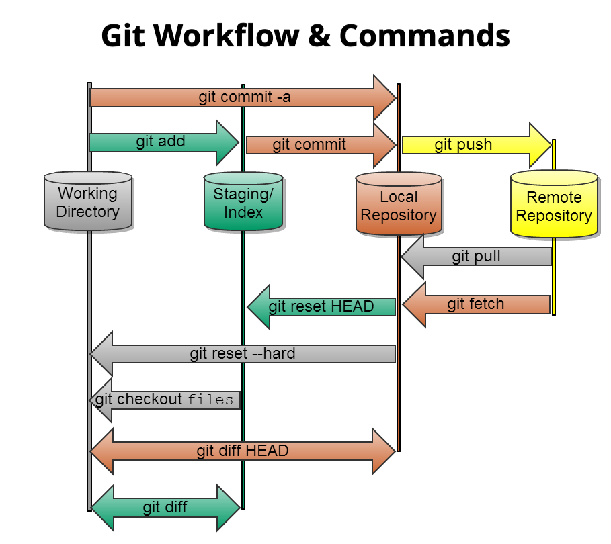
git & github
Git is a free and open source distributed version control system
$ git config --global user.name "My Name"
$ git config --global user.email "myname@gmail.com"
$ git init Demo
$ git clone URL
$ git add Filename
$ git commit -m "Commit Message"
$ git status
$ git push origin master
$ git push --all
$ git pull URL

Slide 34
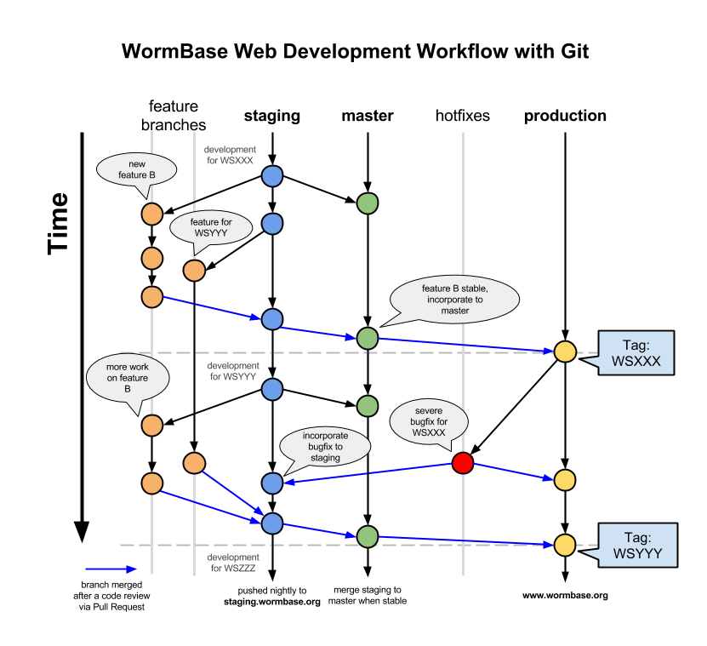
GIT Branches & Workflow

Slide 35
itertools

Slide 36
pathlib

Slide 37
shutil

Slide 38
datetime - Basic date and time types
The datetime module supplies classes for manipulating dates and times.
class datetime.date
class datetime.time
class datetime.datetime
class datetime.timedelta
class datetime.tzinfo
class datetime.timezone
strftime
strptime
from datetime import date
d = date(2020, 2, 28)
print(d.strftime('%Y-%m-%d'))

Slide 39
dateutil, calendar, arrow
The dateutil module provides powerful extensions to the standard datetime module, available in Python.

Slide 40
database access
PEP 249 - Database API Specification 2.0

Slide 41
sqlite3
DB-API 2.0 interface for SQLite databases
import sqlite3
conn = sqlite3.connect('example.db')
c = conn.cursor()
c.execute("""CREATE TABLE stocks
(date text, trans text, symbol text, qty real, price real)""")
c.execute("""INSERT INTO stocks
VALUES ('2006-01-05’, 'BUY’, 'RHAT’, 100, 35.14)""")
conn.commit()
for row in c.execute('SELECT * FROM stocks ORDER BY price'):
print(row)
conn.close()

Slide 42
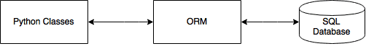

SqlAlchemy
The Python SQL Toolkit and Object Relational Mapper

Slide 43
web applications
django
flask
pyramid
fastapi
dash
streamlit

Slide 44
django
MVC Framework
Models
Object-Relational Mapping
URL Mapping
Views
HTML Templates
Command line bootstrap:
$ mkdir django-demo
$ cd django-demo
$ virtualenv -p python3.5 venv
$ . venv/bin/activate
$ pip install django
$ django-admin
$ django-admin startproject demo
$ python manage.py createsuperuser
$ python manage.py startapp books
$ python manage.py makemigrations
$ python manage.py migrate
$ python manage.py runserver

Slide 45
executables
shebang #!/usr/bin/env python3
py2exe windows
py2app macos

Slide 46
Concurrency
Threading
Asynchronous
Multiprocessing

Slide 47
Concurrency
concurrency
multiprocessing
threading
asynchronous IO
Python Standard Library:
multiprocessing package
threading package
asyncio package and async/await keywords (introduced in Python 3.4)
Notes:
In multiprocessing you leverage multiple CPUs to distribute your calculations. Since each of the CPUs runs in parallel, you're effectively able to run multiple tasks simultaneously. You would want to use multiprocessing for CPU-bound tasks. An example would be trying to calculate a sum of all elements of a huge list. If your machine has 8 cores, you can "cut" the list into 8 smaller lists and calculate the sum of each of those lists separately on separate core and then just add up those numbers. You'll get a ~8x speedup by doing that.
In (multi)threading you don't need multiple CPUs. Imagine a program that sends lots of HTTP requests to the web. If you used a single-threaded program, it would stop the execution (block) at each request, wait for a response, and then continue once received a response. The problem here is that your CPU isn't really doing work while waiting for some external server to do the job; it could have actually done some useful work in the meantime! The fix is to use threads - you can create many of them, each responsible for requesting some content from the web. The nice thing about threads is that, even if they run on one CPU, the CPU from time to time "freezes" the execution of one thread and jumps to executing the other one (it's called context switching and it happens constantly at non-deterministic intervals). So if your task is I/O bound - use threading.
asyncio is essentially threading where not the CPU but you, as a programmer (or actually your application), decide where and when does the context switch happen. In Python you use an await keyword to suspend the execution of your coroutine (defined using async keyword).

Slide 48
Comparison
 | Multiprocessing | Threading | Asynchronous IO
Package | multiprocessing | threading | asyncio
Class | Proces | Thread | Coroutine
Python | Class Proces | Class Thread | Keywords async, await
Data sharing | Message | Shared data
Usage | CPU intensive | IO intensive | IO intensive

Slide 49
Proces versus Thread
True parallelism in Python is achieved by creating multiple processes, each having a Python interpreter with its own separate GIL.
Process | Thread
processes run in separate memory (process isolation) | threads share memory
uses more memory | uses less memory
children can become zombies | no zombies possible
more overhead | less overhead
slower to create and destroy | faster to create and destroy
easier to code and debug | can become harder to code and debug

Slide 50
Python GIL
A global interpreter lock (GIL) is a mechanism used in Python interpreter to synchronize the execution of threads so that only one native thread can execute at a time, even if run on a multi-core processor.
The C extensions, such as numpy, can manually release the GIL to speed up computations. Also, the GIL released before potentionally blocking I/O operations.
Note that both Jython and IronPython do not have the GIL.

Slide 51
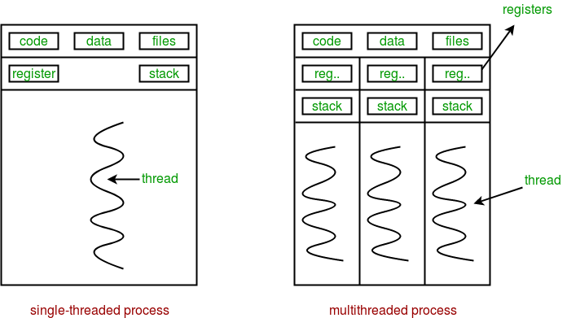
Threading

Slide 52
threading - Thread-based parallelism
Thread
start
run
join
name
active_count
current_thread
main_thread
import time
from threading import Thread
def myfunc(i):
print "sleeping 5 sec from thread %d" % i
time.sleep(5)
print "finished sleeping from thread %d" % i
for i in range(10):
t = Thread(target=myfunc, args=(i,))
t.start()

Slide 53
asyncio
At the heart of async IO are coroutines. A coroutine is a specialized version of a Python generator function.
import asyncio
async def count():
print("One")
await asyncio.sleep(1)
print("Two")
async def main():
await asyncio.gather(count(), count(), count())
if __name__ == "__main__":
import time
s = time.perf_counter()
asyncio.run(main())
elapsed = time.perf_counter() - s
print(f"{__file__} executed in {elapsed:0.2f} seconds.")

Slide 54
multiprocessing
The multiprocessing library is based on spawning Processes.
A process starts a fresh Python interpreter thereby side-stepping the Global Interpreter Lock
The multiprocessing module allows the programmer to fully leverage multiple processors on a given machine.
from multiprocessing import Process def f(name): print('hello', name) if __name__ == '__main__': p = Process(target=f, args=('bob',)) p.start() p.join()

Slide 55
Implementations
CPython reference implementation
IronPython (Python running on .NET)
Jython (Python running on the Java Virtual Machine)
PyPy (A fast python implementation with a JIT compiler)
Stackless Python (Branch of CPython supporting microthreads)
MicroPython (Python running on micro controllers)

Slide 56
Python DBI API 2.0
connect
cursor
execute

Slide 57
RDBMS
SQLite sqlite3
Microsoft SQL Server pyodbc
Oracle
PostgreSQL psycopg2
MySQL mysql-connector-python

Slide 58
NoSQL
NoSQL databases are more flexible than relational databases. In these types of databases, the data storage structure is designed and optimized for specific requirements. There are four main types for NoSQL libraries:
Document-oriented
Key-value pair
Column-oriented
Graph
Python NoSQL:
MongoDB
Redis
Cassandra
Neo4j

Slide 59
SQL
CREATE TABLE
ALTER TABLE
DROP TABLE
INSERT
SELECT
UPDATE
DELETE
CRUD
Create
Read
Update
Delete
LIMIT clause
FROM clause
JOIN clause
WHERE clause
ORDER BY clause
GROUP BY clause

Slide 60
SQLite

Slide 61
PostgreSQL

Slide 62
Links
https://pythonspot.com/python-database/
https://www.geeksforgeeks.org/python-database-tutorial/
https://www.tutorialspoint.com/postgresql/index.htm

Slide 63
Links
https://www.geeksforgeeks.org/python-database-tutorial/

Slide 64
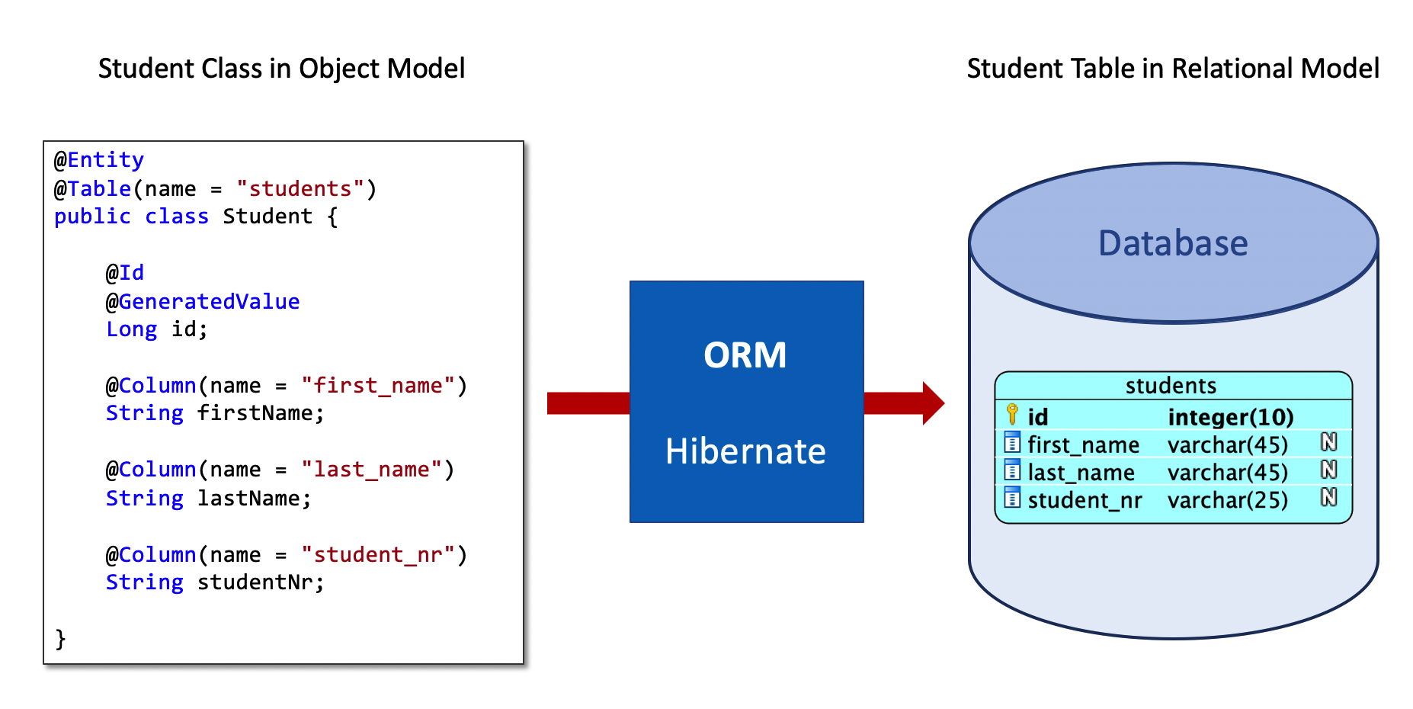
SqlAlchemy

Slide 65
requests – HTTP for Humans
Requests is an elegant and simple HTTP library for Python, built for human beings.
import requests
url = "http://api.openweathermap.org/data/2.5/weather"
url += "?appid=d1526a9039658a6f76950cff21823aff"
url += "&units=metric"
url += "&mode=json"
url += "&q=New York"
response = requests.get(url)
if (response.status_code == 200):
body = response.text
decoded = response.json() temperature = decoded['main']['temp']
else:
print("Error for city %s" % (city))

Slide 66
Web Frameworks
Django
Flask
Pyramid
Bottle
Sierra
FastAPI

Slide 67
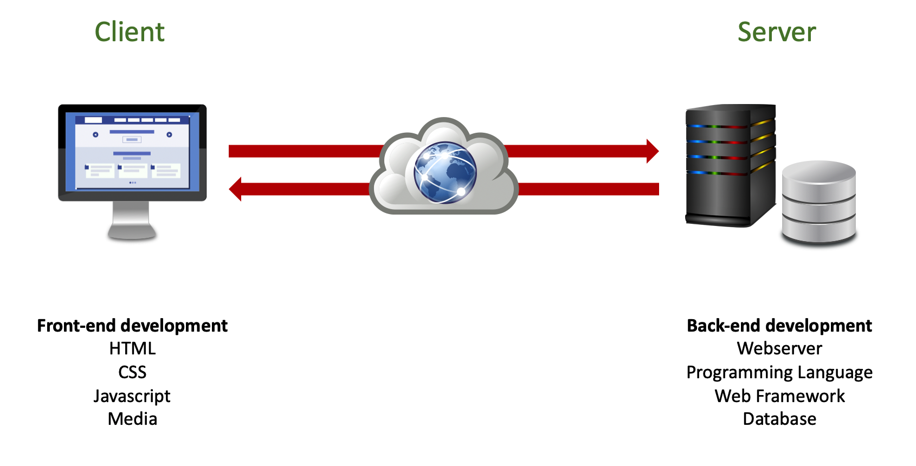
Web Framework
Routing
Database ORM
Templating

Slide 68
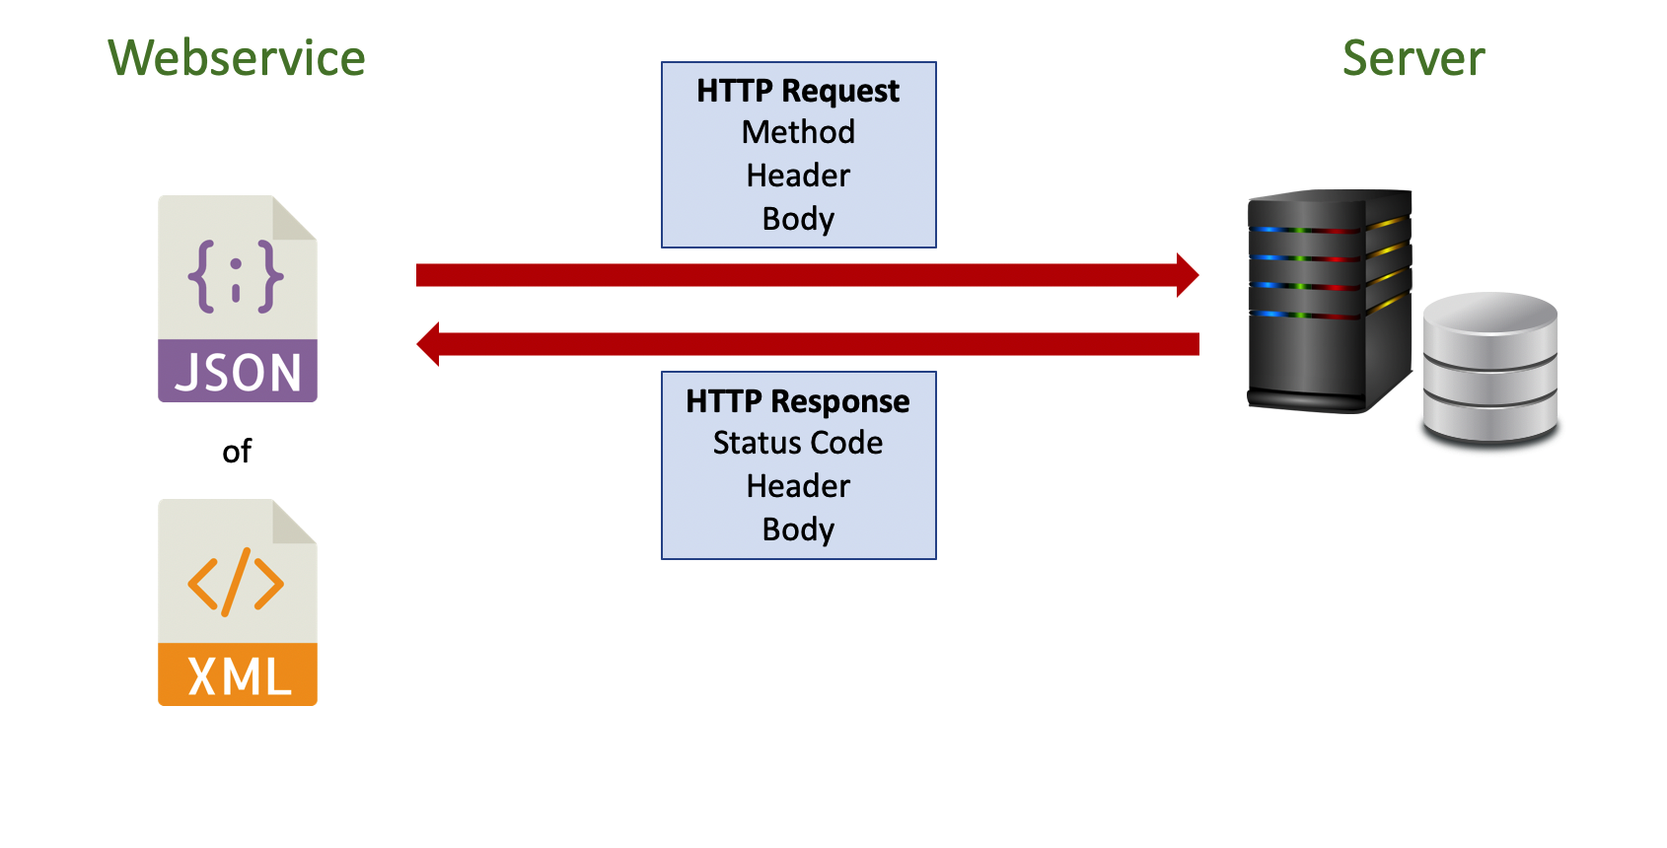
RESTful
Client – Server
Http Verbs – Get, Post, Put, Delete => CRUD
Payload – Data - JSON

Slide 69
django
MVC Framework
Models
Object-Relational Mapping
URL Mapping
Views
HTML Templates
Command line bootstrap:
$ mkdir django-demo
$ cd django-demo
$ virtualenv -p python3.5 venv
$ . venv/bin/activate
$ pip install django
$ django-admin
$ django-admin startproject demo
$ python manage.py createsuperuser
$ python manage.py startapp books
$ python manage.py makemigrations
$ python manage.py migrate
$ python manage.py runserver

Slide 70

Flask
Flask is a micro web framework written in Python. It is classified as a microframework because it does not require particular tools or libraries.^{[2]} It has no database abstraction layer, form validation, or any other components where pre-existing third-party libraries provide common functions. However, Flask supports extensions that can add application features as if they were implemented in Flask itself. Extensions exist for object-relational mappers, form validation, upload handling, various open authentication technologies and several common framework related tools.
Notes:
https://code.tutsplus.com/tutorials/templating-with-jinja2-in-flask-essentials--cms-25571

Slide 71
FastAPI
Notes:
FastAPI tutorial codingwithroby https://www.youtube.com/watch?v=MCVcAAoDJS8 https://www.youtube.com/watch?v=34jQRPssM5Q source code https://github.com/codingwithroby/FastAPI-The-Complete-Course

Slide 72
GUI Frameworks
TkInter - The traditional Python user interface toolkit.
PyQt - Bindings for the cross-platform Qt framework.
PySide - PySide is a newer binding to the Qt toolkit
wxPython - a cross-platform GUI toolkit that is built around wxWidgets
Win32Api - native window dialogs
PyMsgBox
Dash
Jupyter Widgets

Slide 73
tkinter
The tkinter package (“Tk interface”) is the standard Python interface to the Tk GUI toolkit.
There are also Standard Dialogs
import tkinter as tk
import tkMessageBox
top = tk.Tk()
def hello():
tkMessageBox.showinfo("Say Hello", "Hello World")
btn1 = tk.Button(top, text = "Say Hello", command = hello)
btn1.pack()
top.mainloop()
Notes:
https://stackoverflow.com/questions/7546050/switch-between-two-frames-in-tkinter

Slide 74
tkinter
Tkinter Frame
Tkinter Button
Tkinter Label
Tkinter Entry
Tkinter Radio Button
Tkinter Check Button
Tkinter Combobox
Tkinter Menu Button
Tkinter Toplevel
Tkinter Scrollbar
Tkinter Menu
Tkinter List Box
Tkinter Text Widget
Tkinter Canvas
Tkinter Scale
Tkinter LabelFrame
Tkinter SpinBox
Tkinter Color Chooser
widgets
Layout Managers
pack
grid
place
Notes:
https://python-course.eu/tkinter/layout-management-in-tkinter.php

Slide 75
Distributions
py2exe
py2app

